Slide 1
INSTANCE BASED LEARNING VS MODEL BASED LEARNING
college To corporate

Slide 2
INSTANCE BASED LEARNING
Instance-based learning is like learning from examples. Imagine you're trying to identify animals. Instead of having a rulebook, instance-based learning works by comparing new animals to ones you already know. If a new animal looks a lot like a dog you've seen before, you'd guess it's a dog too. It's like saying, "If it looks like a duck, swims like a duck, and quacks like a duck, then it probably is a duck." This method doesn't rely on strict rules; instead, it learns by remembering past examples and making decisions based on similarity. So, in essence, instance-based learning is learning by comparing new things to old ones.
Example of instance based learning is KNN Algorithm

Slide 3
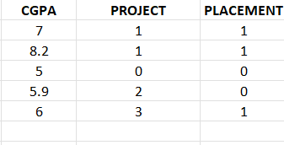
Instance
In instance based learning model store/keep data and when new data is come it predict output based on similarities

Slide 4

MODEL BASED LEARNING

Slide 5
Model Based learning
Model based learning is try to find relationship between datapoints
In model based learning we generate or train a model by datasets
In model based learning, even if the training data is removed it does not make any difference.
In model based learning model makes a generalize rule
Example of model based learning is Logistic regression Linear regression random forest

